Slide 1
Decision Sciences- 1
Anirban Ghatak

Slide 2
Data and Statistics
Statistics
Applications in Business and Economics
Data
Data Sources
Descriptive Statistics
Statistical Inference

Slide 3
Statistics
The term statistics can refer to numerical facts such as averages, medians, percents, and index numbers that help us understand a variety of business and economic situations.
Statistics can also refer to the art and science of collecting, analyzing, presenting, and interpreting data.

Slide 4
Applications in
Business and Economics
Accounting
Public accounting firms use statistical sampling
procedures when conducting audits for their clients.
Economics
Economists use statistical information in making
forecasts about the future of the economy or some
aspect of it.
Finance
Financial advisors use price-earnings ratios and
dividend yields to guide their investment advice.

Slide 5
Applications in
Business and Economics
Marketing
Electronic point-of-sale scanners at retail checkout
counters are used to collect data for a variety of
marketing research applications.
Production
A variety of statistical quality control charts are used
to monitor the output of a production process.
Information Systems
A variety of statistical information helps administrators
assess the performance of computer networks.

Slide 6
Data and Data Sets
Data are the facts and figures collected, analyzed,
and summarized for presentation and interpretation.
All the data collected in a particular study are referred
to as the data set for the study.

Slide 7
Elements, Variables, and Observations
Elements are the entities on which data are collected.
A variable is a characteristic of interest for the elements.
The set of measurements obtained for a particular
element is called an observation.
A data set with n elements contains n observations.
The total number of data values in a complete data
set is the number of elements multiplied by the
number of variables.

Slide 8
Data, Data Sets,
Elements, Variables, and Observations
Observation
Variables
Element
Names
Stock Annual Earn/
Exchange Sales($M) Share($)
Company
Dataram
EnergySouth
Keystone
LandCare
Psychemedics
NQ 73.10 0.86
N 74.00 1.67
N 365.70 0.86
NQ 111.40 0.33
N 17.60 0.13
Data Set

Slide 9
Scales of Measurement
Scales of measurement include:
Nominal
Interval
Ordinal
Ratio
The scale determines the amount of information
contained in the data.
The scale indicates the data summarization and
statistical analyses that are most appropriate.

Slide 10
Scales of Measurement
Nominal
Data are labels or names used to identify an
attribute of the element.
A nonnumeric label or numeric code may be used.

Slide 11
Scales of Measurement
Nominal
Example:
Students of a university are classified by the
school in which they are enrolled using a
nonnumeric label such as Business, Humanities,
Education, and so on.
Alternatively, a numeric code could be used for
the school variable (e.g. 1 denotes Business,
2 denotes Humanities, 3 denotes Education, and
so on).

Slide 12
Scales of Measurement
Ordinal
The data have the properties of nominal data and
the order or rank of the data is meaningful.
A nonnumeric label or numeric code may be used.

Slide 13
Scales of Measurement
Ordinal
Example:
Students of a university are classified by their
class standing using a nonnumeric label such as
Freshman, Sophomore, Junior, or Senior.
Alternatively, a numeric code could be used for
the class standing variable (e.g. 1 denotes
Freshman, 2 denotes Sophomore, and so on).

Slide 14
Scales of Measurement
Interval
The data have the properties of ordinal data, and
the interval between observations is expressed in
terms of a fixed unit of measure.
Interval data are always numeric.

Slide 15
Scales of Measurement
Interval
Example:
Melissa has an SAT score of 1985, while Kevin
has an SAT score of 1880. Melissa scored 105
points more than Kevin.

Slide 16
Scales of Measurement
Ratio
The data have all the properties of interval data
and the ratio of two values is meaningful.
Variables such as distance, height, weight, and time
use the ratio scale.
This scale must contain a zero value that indicates
that nothing exists for the variable at the zero point.

Slide 17
Scales of Measurement
Ratio
Example:
Melissa’s college record shows 36 credit hours
earned, while Kevin’s record shows 72 credit
hours earned. Kevin has twice as many credit
hours earned as Melissa.

Slide 18
Categorical and Quantitative Data
Data can be further classified as being categorical
or quantitative.
The statistical analysis that is appropriate depends
on whether the data for the variable are categorical
or quantitative.
In general, there are more alternatives for statistical
analysis when the data are quantitative.

Slide 19
Categorical Data
Labels or names used to identify an attribute of
each element
Often referred to as qualitative data
Use either the nominal or ordinal scale of
measurement
Can be either numeric or nonnumeric
Appropriate statistical analyses are rather limited

Slide 20
Quantitative Data
Quantitative data indicate how many or how much:
discrete, if measuring how many
continuous, if measuring how much
Quantitative data are always numeric.
Ordinary arithmetic operations are meaningful for
quantitative data.

Slide 21
Scales of Measurement
Data
Categorical
Quantitative
Numeric
Non-numeric
Numeric
Nominal
Ordinal
Nominal
Ordinal
Interval
Ratio

Slide 22
Cross-Sectional Data
Cross-sectional data are collected at the same or
approximately the same point in time.
Example: data detailing the number of building
permits issued in November 2012 in each of the
counties of Ohio

Slide 23
Time Series Data
Time series data are collected over several time
periods.
Example: data detailing the number of building
permits issued in Lucas County, Ohio in each of
the last 36 months
Graphs of time series help analysts understand
  what happened in the past,
  identify any trends over time, and
  project future levels for the time series

Slide 24
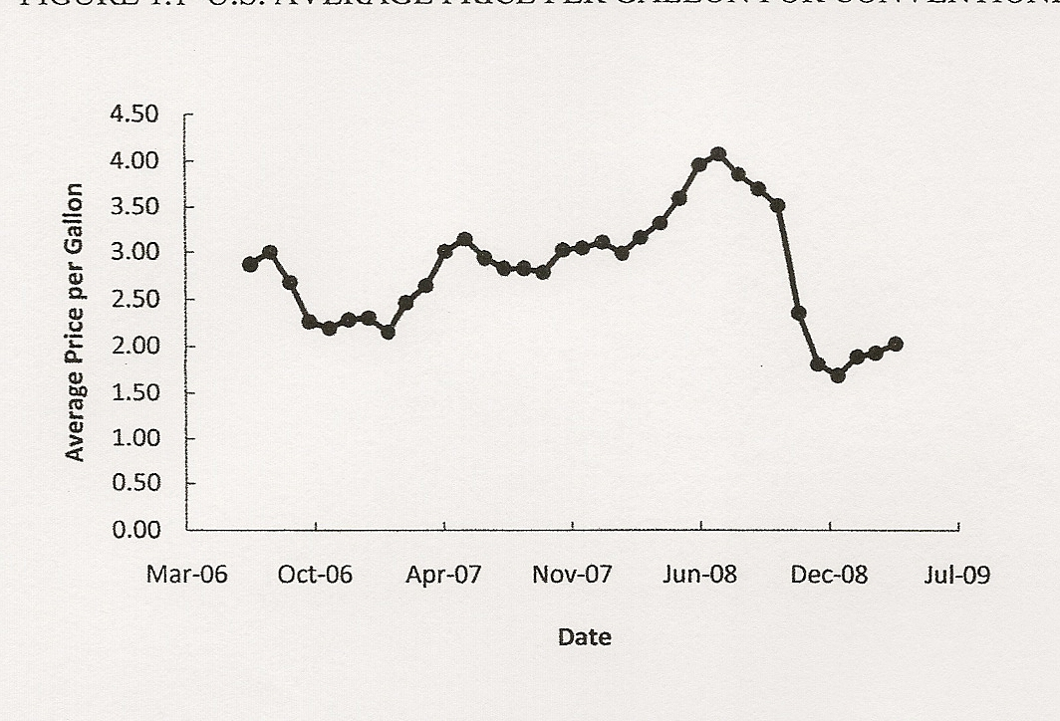
Time Series Data
Graph of Time Series Data
U.S. Average Price Per Gallon
For Conventional Regular Gasoline
Source: Energy Information Administration, U.S. Department of Energy, May 2009.

Slide 25
Data Sources
Statistical Studies - Experimental
  In experimental studies the variable of interest is
  first identified. Then one or more other variables
  are identified and controlled so that data can be
  obtained about how they influence the variable of
  interest.
The largest experimental study ever conducted is
believed to be the 1954 Public Health Service
experiment for the Salk polio vaccine. Nearly two
million U.S. children (grades 1- 3) were selected.

Slide 26
Data Sources
Statistical Studies - Observational
In observational (nonexperimental) studies no
attempt is made to control or influence the
variables of interest.
a survey is a good example
Studies of smokers and nonsmokers are
observational studies because researchers
do not determine or control
who will smoke and who will not smoke.

Slide 27
Descriptive Statistics
Most of the statistical information in newspapers, magazines, company reports, and other publications consists of data that are summarized and presented in a form that is easy to understand.
Such summaries of data, which may be tabular, graphical, or numerical, are referred to as descriptive statistics.

Slide 28
Example: Hudson Auto Repair
The manager of Hudson Auto would like to have a
better understanding of the cost of parts used in the
engine tune-ups performed in her shop. She examines
50 customer invoices for tune-ups. The costs of parts,
rounded to the nearest dollar, are listed on the next
slide.

Slide 29
Example: Hudson Auto Repair
Sample of Parts Cost ($) for 50 Tune-ups

Slide 30
Tabular Summary:
Frequency and Percent Frequency
Example: Hudson Auto
Parts
Cost ($)
Frequency
Percent
Frequency
2
13
16
7
7
5
50
4
26
32
14
14
10
100
50-59
60-69
70-79
80-89
90-99
100-109
(2/50)100

Slide 31
Graphical Summary: Histogram
Example: Hudson Auto
18
Tune-up Parts Cost
16
14
12
10
Frequency
8
6
4
2
Parts
Cost ($)
50−59 60−69 70−79 80−89 90−99 100-110

Slide 32
Numerical Descriptive Statistics
The most common numerical descriptive statistic
is the average (or mean).
The average demonstrates a measure of the central
tendency, or central location, of the data for a variable.
Hudson’s average cost of parts, based on the 50
tune-ups studied, is $79 (found by summing the
50 cost values and then dividing by 50).

Slide 33
Statistical Inference
Population
− the set of all elements of interest in a
particular study
Sample
− a subset of the population
Statistical inference
− the process of using data obtained
from a sample to make estimates
and test hypotheses about the
characteristics of a population
Census
− collecting data for the entire population
Sample survey
− collecting data for a sample

Slide 34
Process of Statistical Inference
1. Population
consists of all tune-
ups. Average cost of
parts is unknown.
2. A sample of 50
engine tune-ups
is examined.
4. The sample average
is used to estimate the
population average.
The sample data
provide a sample
average parts cost
of $79 per tune-up.

Slide 35
Descriptive Statistics:
Tabular and Graphical Displays
Summarizing Data for a Categorical Variable
Summarizing Data for a Quantitative Variable
Categorical data use labels or names
to identify categories of like items.
Quantitative data are numerical values
that indicate how much or how many.

Slide 36
Summarizing Categorical Data
Frequency Distribution
Relative Frequency Distribution
Percent Frequency Distribution
Bar Chart
Pie Chart

Slide 37
Frequency Distribution
A frequency distribution is a tabular summary of
data showing the number (frequency) of
observations in each of several non-overlapping
categories or classes.
The objective is to provide insights about the data
that cannot be quickly obtained by looking only at
the original data.

Slide 38
Frequency Distribution
Example: Marada Inn
Guests staying at Marada Inn were asked to rate the
quality of their accommodations as being excellent,
above average, average, below average, or poor. The
ratings provided by a sample of 20 guests are:
Below Average
Above Average
Above Average
Average
Above Average
Average
Above Average
Average
Above Average
Below Average
Poor
Excellent
Above Average
Average
Above Average
Above Average
Below Average
Poor
Above Average
Average

Slide 39
Frequency Distribution
Example: Marada Inn
Poor
Below Average
Average
Above Average
Excellent
2
3
5
9
1
Total 20
Rating
Frequency

Slide 40
Relative Frequency Distribution
The relative frequency of a class is the fraction or
proportion of the total number of data items
belonging to the class.
A relative frequency distribution is a tabular
summary of a set of data showing the relative
frequency for each class.

Slide 41
Percent Frequency Distribution
The percent frequency of a class is the relative
frequency multiplied by 100.
A percent frequency distribution is a tabular
summary of a set of data showing the percent
frequency for each class.

Slide 42
Relative Frequency and
Percent Frequency Distributions
Example: Marada Inn
Relative
Frequency
Percent
Frequency
Rating
Poor
Below Average
Average
Above Average
Excellent
.10
.15
.25
.45
.05
Total 1.00
10
15
25
45
5
100
.10(100) = 10
1/20 = .05

Slide 43
Bar Chart
A bar chart is a graphical display for depicting
qualitative data.
On one axis (usually the horizontal axis), we specify
the labels that are used for each of the classes.
A frequency, relative frequency, or percent frequency
scale can be used for the other axis (usually the
vertical axis).
Using a bar of fixed width drawn above each class
label, we extend the height appropriately.
  The bars are separated to emphasize the fact that each
  class is a separate category.

Slide 44
Bar Chart
Marada Inn Quality Ratings
10
9
8
7
6
Frequency
5
4
3
2
1
Rating
Poor
Below
Average
Average
Above
Average
Excellent

Slide 45
Pareto Diagram
In quality control, bar charts are used to identify the
most important causes of problems.
When the bars are arranged in descending order of
height from left to right (with the most frequently
occurring cause appearing first) the bar chart is
called a Pareto diagram.
This diagram is named for its founder, Vilfredo
Pareto, an Italian economist.

Slide 46
Pie Chart
The pie chart is a commonly used graphical display
for presenting relative frequency and percent
frequency distributions for categorical data.
First draw a circle; then use the relative frequencies
to subdivide the circle into sectors that correspond to
the relative frequency for each class.
Since there are 360 degrees in a circle, a class with a
relative frequency of .25 would consume .25(360) = 90
degrees of the circle.

Slide 47
Pie Chart
Marada Inn Quality Ratings
Excellent
5%
Poor
10%
Below
Average
15%
Above
Average
45%
Average
25%

Slide 48
Example: Marada Inn
Insights Gained from the Preceding Pie Chart
One-half of the customers surveyed gave Marada
a quality rating of “above average” or “excellent”
(looking at the left side of the pie). This might
please the manager.
For each customer who gave an “excellent” rating,
there were two customers who gave a “poor”
rating (looking at the top of the pie). This should
displease the manager.

Slide 49
Summarizing Quantitative Data
Frequency Distribution
Relative Frequency and
Percent Frequency Distributions
Dot Plot
Histogram
Cumulative Distributions
Stem-and-Leaf Displays

Slide 50
Frequency Distribution
Example: Hudson Auto Repair
The manager of Hudson Auto would like to gain a
better understanding of the cost of parts used in the
engine tune-ups performed in the shop. She examines
50 customer invoices for tune-ups. The costs of parts,
rounded to the nearest dollar, are listed on the next
slide.

Slide 51
Frequency Distribution
Example: Hudson Auto Repair
Sample of Parts Cost($) for 50 Tune-ups

Slide 52
Frequency Distribution
The three steps necessary to define the classes for a
frequency distribution with quantitative data are:
1. Determine the number of non-overlapping classes.
2. Determine the width of each class.
3. Determine the class limits.

Slide 53
Frequency Distribution
Guidelines for Determining the Number of Classes
Use between 5 and 20 classes.
Data sets with a larger number of elements
usually require a larger number of classes.
Smaller data sets usually require fewer classes.
The goal is to use enough classes to show the
variation in the data, but not so many classes
that some contain only a few data items.

Slide 54
Frequency Distribution
Guidelines for Determining the Width of Each Class
Use classes of equal width.
Approximate Class Width =
Making the classes the same
width reduces the chance of
inappropriate interpretations.

Slide 55
Frequency Distribution
Note on Number of Classes and Class Width
In practice, the number of classes and the
appropriate class width are determined by trial
and error.
Once a possible number of classes is chosen, the
appropriate class width is found.
The process can be repeated for a different
number of classes.
Ultimately, the analyst uses judgment to
determine the combination of the number of
classes and class width that provides the best
frequency distribution for summarizing the data.

Slide 56
Frequency Distribution
Guidelines for Determining the Class Limits
Class limits must be chosen so that each data
item belongs to one and only one class.
The lower class limit identifies the smallest
possible data value assigned to the class.
The upper class limit identifies the largest
possible data value assigned to the class.
The appropriate values for the class limits
depend on the level of accuracy of the data.
An open-end class requires only a
lower class limit or an upper class limit.

Slide 57
Frequency Distribution
Example: Hudson Auto Repair
If we choose six classes:
Approximate Class Width = (109 - 52)/6 = 9.5 ≅ 10
50-59
60-69
70-79
80-89
90-99
100-109
2
13
16
7
7
5
Total 50
Parts Cost ($)
Frequency

Slide 58
Relative Frequency and
Percent Frequency Distributions
Example: Hudson Auto Repair
Parts
Cost ($)
Relative
Frequency
Percent
Frequency
50-59
60-69
70-79
80-89
90-99
100-109
.04
.26
.32
.14
.14
.10
Total 1.00
4
26
32
14
14
10
100
2/50
.04(100)
Percent
frequency is
the relative
frequency
multiplied
by 100.

Slide 59
Relative Frequency and
Percent Frequency Distributions
Example: Hudson Auto Repair
Insights Gained from the % Frequency Distribution:
Only 4% of the parts costs are in the $50-59 class.
30% of the parts costs are under $70.
The greatest percentage (32% or almost one-third)
of the parts costs are in the $70-79 class.
10% of the parts costs are $100 or more.

Slide 60
Dot Plot
One of the simplest graphical summaries of data is a dot plot.
A horizontal axis shows the range of data values.
Then each data value is represented by a dot placed above the axis.

Slide 61
Dot Plot
Example: Hudson Auto Repair
Tune-up Parts Cost
50 60 70 80 90 100 110
Cost ($)

Slide 62
Histogram
Another common graphical display of quantitative
data is a histogram.
The variable of interest is placed on the horizontal
axis.
A rectangle is drawn above each class interval with
its height corresponding to the interval’s frequency,
relative frequency, or percent frequency.
Unlike a bar graph, a histogram has no natural
separation between rectangles of adjacent classes.

Slide 63
Histogram
Example: Hudson Auto Repair
18
Tune-up Parts Cost
16
14
12
10
Frequency
8
6
4
2
Parts
Cost ($)
50−59 60−69 70−79 80−89 90−99 100-110

Slide 64
Histograms Showing Skewness
Symmetric
  Left tail is the mirror image of the right tail
  Examples: Heights of People
.35
.30
.25
.20
Relative Frequency
.15
.10
.05
0

Slide 65
Histograms Showing Skewness
Moderately Skewed Left
  A longer tail to the left
  Example: Exam Scores
.35
.30
.25
.20
Relative Frequency
.15
.10
.05
0

Slide 66
Histograms Showing Skewness
Moderately Right Skewed
  A Longer tail to the right
  Example: Housing Values
.35
.30
.25
.20
Relative Frequency
.15
.10
.05
0

Slide 67
Histograms Showing Skewness
Highly Skewed Right
  A very long tail to the right
  Example: Executive Salaries
.35
.30
.25
.20
Relative Frequency
.15
.10
.05
0

Slide 68
Cumulative Distributions
Cumulative frequency distribution − shows the
number of items with values less than or equal to the
upper limit of each class..
Cumulative relative frequency distribution – shows
the proportion of items with values less than or
equal to the upper limit of each class.
Cumulative percent frequency distribution – shows
the percentage of items with values less than or
equal to the upper limit of each class.

Slide 69
Cumulative Distributions
The last entry in a cumulative frequency distribution
always equals the total number of observations.
The last entry in a cumulative relative frequency
distribution always equals 1.00.
The last entry in a cumulative percent frequency
distribution always equals 100.

Slide 70
Cumulative Distributions
Hudson Auto Repair
Cumulative
Relative
Frequency
Cumulative
Percent
Frequency
Cumulative
Frequency
< 59
< 69
< 79
< 89
< 99
< 109
Cost ($)
2
15
31
38
45
50
.04
.30
.62
.76
.90
1.00
4
30
62
76
90
100
2 + 13
15/50
.30(100)

Slide 71
Stem-and-Leaf Display
A stem-and-leaf display shows both the rank order
and shape of the distribution of the data.
It is similar to a histogram on its side, but it has the
advantage of showing the actual data values.
The first digits of each data item are arranged to the
left of a vertical line.
To the right of the vertical line we record the last
digit for each item in rank order.
Each line in the display is referred to as a stem.
Each digit on a stem is a leaf.

Slide 72
Example: Hudson Auto Repair
The manager of Hudson Auto would like to gain a
better understanding of the cost of parts used in the
engine tune-ups performed in the shop. She examines
50 customer invoices for tune-ups. The costs of parts,
rounded to the nearest dollar, are listed on the next
slide.

Slide 73
Stem-and-Leaf Display
Example: Hudson Auto Repair
Sample of Parts Cost ($) for 50 Tune-ups

Slide 74
Stem-and-Leaf Display
Example: Hudson Auto Repair
5
6
7
8
9
10
2 7
2 2 2 2 5 6 7 8 8 8 9 9 9
1 1 2 2 3 4 4 5 5 5 6 7 8 9 9 9
0 0 2 3 5 8 9
1 3 7 7 7 8 9
1 4 5 5 9
a stem
a leaf

Slide 75
Stretched Stem-and-Leaf Display
If we believe the original stem-and-leaf display has
condensed the data too much, we can stretch the
display vertically by using two stems for each
leading digit(s).
Whenever a stem value is stated twice, the first value
corresponds to leaf values of 0 − 4, and the second
value corresponds to leaf values of 5 − 9.

Slide 76
Stretched Stem-and-Leaf Display
Example: Hudson Auto Repair
5
5
6
6
7
7
8
8
9
9
10
10
2
7
2 2 2 2
5 6 7 8 8 8 9 9 9
1 1 2 2 3 4 4
5 5 5 6 7 8 9 9 9
0 0 2 3
5 8 9
1 3
7 7 7 8 9
1 4
5 5 9

Slide 77
Stem-and-Leaf Display
Leaf Units
A single digit is used to define each leaf.
In the preceding example, the leaf unit was 1.
  Leaf units may be 100, 10, 1, 0.1, and so on.
Where the leaf unit is not shown, it is assumed
to equal 1.
The leaf unit indicates how to multiply the stem-
and-leaf numbers in order to approximate the
original data.

Slide 78
Example: Leaf Unit = 0.1
If we have data with values such as
8.6 11.7 9.4 9.1 10.2 11.0 8.8
a stem-and-leaf display of these data will be
Leaf Unit = 0.1
8
9
10
11
6 8
1 4
2
0 7

Slide 79
Example: Leaf Unit = 10
If we have data with values such as
1806 1717 1974 1791 1682 1910 1838
a stem-and-leaf display of these data will be
Leaf Unit = 10
16
17
18
19
8
The 82 in 1682
is rounded down
to 80 and is
represented as an 8.
1 9
0 3
1 7

Slide 80
Descriptive Statistics:
Tabular and Graphical Displays
Summarizing Data for Two Variables
Using Tables
Summarizing Data for Two Variables
Using Graphical Displays
Data Visualization: Best Practices in Creating
Effective Graphical Displays

Slide 81
Summarizing Data for Two Variables
Using Tables
Thus far we have focused on methods that are used
to summarize the data for one variable at a time.
Often a manager is interested in tabular and
graphical methods that will help understand the
relationship between two variables.
Crosstabulation is a method for summarizing the
data for two variables.

Slide 82
Crosstabulation
A crosstabulation is a tabular summary of data for
two variables.
Crosstabulation can be used when:
  one variable is qualitative and the other is
  quantitative,
  both variables are qualitative, or
  both variables are quantitative.
The left and top margin labels define the classes for
the two variables.

Slide 83
Crosstabulation
Example: Finger Lakes Homes
The number of Finger Lakes homes sold for each
style and price for the past two years is shown below.
quantitative
variable
categorical
variable
Price
Range
Home Style
Colonial Log Split A-Frame
Total
< $200,000
> $200,000
18 6 19 12
55
45
12 14 16 3
Total
30 20 35 15
100

Slide 84
Crosstabulation
Example: Finger Lakes Homes
Insights Gained from Preceding Crosstabulation
The greatest number of homes (19) in the sample
are a split-level style and priced at less than
$200,000.
Only three homes in the sample are an A-Frame
style and priced at $200,000 or more.

Slide 85
Crosstabulation
Frequency
distribution
for the
price range
variable
Example: Finger Lakes Homes
Price
Range
Home Style
Colonial Log Split A-Frame
Total
< $200,000
> $200,000
18 6 19 12
55
45
12 14 16 3
Total
30 20 35 15
100
Frequency distribution for
the home style variable

Slide 86
Crosstabulation: Row or Column Percentages
Converting the entries in the table into row percentages or column percentages can provide additional insight about the relationship between the two variables.

Slide 87
Crosstabulation: Row Percentages
Example: Finger Lakes Homes
Price
Range
Home Style
Colonial Log Split A-Frame
Total
< $200,000
> $200,000
32.73 10.91 34.55 21.82
100
100
26.67 31.11 35.56 6.67
Note: row totals are actually 100.01 due to rounding.
(Colonial and > $200K)/(All > $200K) x 100 = (12/45) x 100

Slide 88
Crosstabulation: Column Percentages
Example: Finger Lakes Homes
Price
Range
Home Style
Colonial Log Split A-Frame
< $200,000
> $200,000
60.00 30.00 54.29 80.00
40.00 70.00 45.71 20.00
Total
100 100 100 100
(Colonial and > $200K)/(All Colonial) x 100 = (12/30) x 100

Slide 89
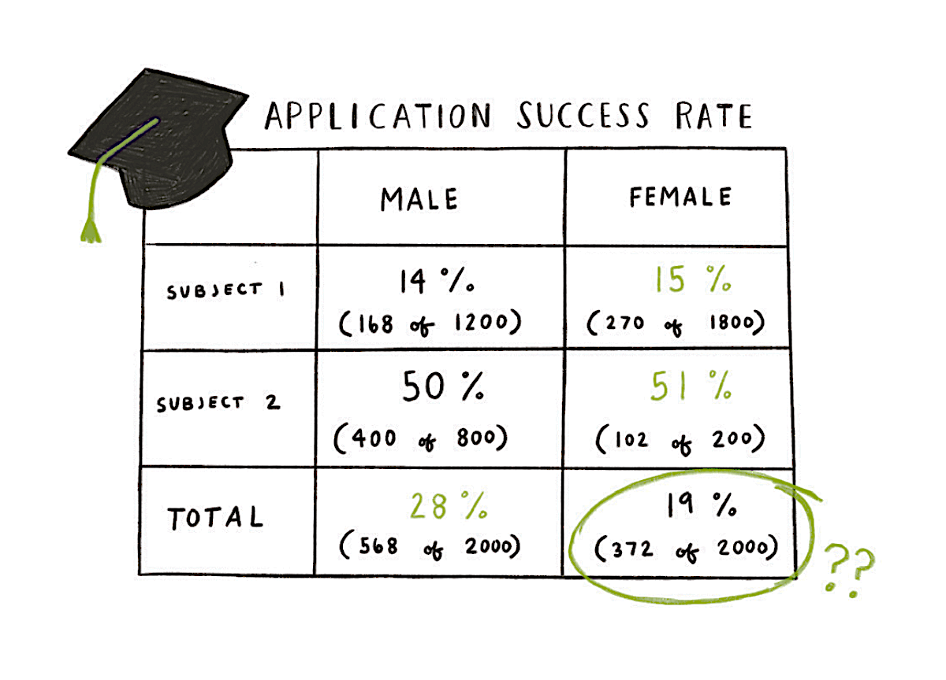
Crosstabulation: A Confusing Example

Slide 90
Simpson’s Paradox
Data in two or more crosstabulations are often
aggregated to produce a summary crosstabulation.
We must be careful in drawing conclusions about the
relationship between the two variables in the
aggregated crosstabulation.
In some cases the conclusions based upon an
aggregated crosstabulation can be completely
reversed if we look at the unaggregated data. The
reversal of conclusions based on aggregate and
unaggregated data is called Simpson’s paradox.

Slide 91
Summarizing Data for Two Variables
Using Graphical Displays
In most cases, a graphical display is more useful than
a table for recognizing patterns and trends.
Displaying data in creative ways can lead to powerful
insights.
Scatter diagrams and trendlines are useful in
exploring the relationship between two variables.

Slide 92
Scatter Diagram and Trendline
A scatter diagram is a graphical presentation of the
relationship between two quantitative variables.
One variable is shown on the horizontal axis and
the other variable is shown on the vertical axis.
The general pattern of the plotted points suggests
the overall relationship between the variables.
A trendline provides an approximation of the
relationship.

Slide 93
Scatter Diagram
A Positive Relationship
y
x

Slide 94
Scatter Diagram
A Negative Relationship
y
x

Slide 95
Scatter Diagram
No Apparent Relationship
y
x

Slide 96
Scatter Diagram
Example: Panthers Football Team
The Panthers football team is interested in
investigating the relationship, if any, between
interceptions made and points scored.
x = Number of
Interceptions
y = Number of
Points Scored
1
3
2
1
3
14
24
18
17
30

Slide 97
Scatter Diagram and Trendline
y
35
30
25
20
Number of Points Scored
15
10
5
0
x
0
1
2
3
4
Number of Interceptions

Slide 98
Example: Panthers Football Team
Insights Gained from the Preceding Scatter Diagram
The scatter diagram indicates a positive relationship
between the number of interceptions and the
number of points scored.
Higher points scored are associated with a higher
number of interceptions.
The relationship is not perfect; all plotted points in
the scatter diagram are not on a straight line.

Slide 99
Side-by-Side Bar Chart
A side-by-side bar chart is a graphical display for
depicting multiple bar charts on the same display.
Each cluster of bars represents one value of the
first variable.
Each bar within a cluster represents one value of
the second variable.

Slide 100
Side-by-Side Bar Chart
Finger Lake Homes
20
18
16
14
12
< $200,000
Frequency
> $200,000
10
8
6
4
2
Home Style
Colonial
Log
Split-Level
A-Frame

Slide 101
Stacked Bar Chart
A stacked bar chart is another way to display and
compare two variables on the same display.
It is a bar chart in which each bar is broken into
rectangular segments of a different color.
If percentage frequencies are displayed, all bars
will be of the same height (or length), extending to
the 100% mark.

Slide 102
Stacked Bar Chart
Finger Lake Homes
40
36
32
28
24
< $200,000
Frequency
> $200,000
20
16
12
8
4
Home Style
Colonial
Log
Split
A-Frame

Slide 103
Tabular and Graphical Displays
Data
Categorical Data
Quantitative Data
Tabular
Displays
Graphical
Displays
Tabular
Displays
Graphical
Displays
Frequency
Distribution
Rel. Freq. Dist.
Percent Freq.
Distribution
Crosstabulation
Dot Plot
Histogram
Stem-and-
Leaf Display
Scatter
Diagram
Bar Chart
Pie Chart
Side-by-Side
Bar Chart
Stacked
Bar Chart
Frequency
Distribution
Rel. Freq. Dist.
% Freq. Dist.
Cum. Freq. Dist.
Cum. Rel. Freq.
Distribution
Cum. % Freq.
Distribution
Crosstabulation

